Slide 1

4 YEARS, 1,000 POSSIBILITIES
MAKE THE MOST OF YOUR COLLEGE LIFE AND YOUR MONEY
STUDENT BANKING FROM PNC BANK
PNC Bank Temple Branch
1908 Liacouras Walk
2020
©2020 The PNC Financial Services Group, Inc. All rights reserved. PNC Bank, National Association. Member FDIC

Slide 2






VIRTUAL WALLET STUDENT ®
Designed to meet the unique needs of students
CONVENIENT BRANCHES ON CAMPUS
Located at 1908 Liacouras Walk for all of your banking needs
CAMPUS PNC ATMs
15 PNC ATMs on campus where PNC customers can access their money fee free — find the one nearest you at pnc.com/locator
OWLcard ID LINKING
Link your Virtual Wallet Student to your student ID and use it as an ATM card
PNC BANK VISA® DEBIT CARD
Custom-designed to show your school pride
PNC BANK +
TEMPLE
UNIVERSITY
©2020 The PNC Financial Services Group, Inc. All rights reserved. PNC Bank, National Association. Member FDIC

Slide 3





EXCITED ABOUT COLLEGE?
We can help you make the most of it.
PNC Student Banking can help you manage your money — and your life on campus — with features that let you bank the way that works best for you.
VIRTUAL WALLET STUDENT®
    AVOID SERVICE CHARGE
    Avoid the monthly service charge for the first 6 years from
    the date of account opening.¹
    COURTESY OVERDRAFT FEE REFUND
    One courtesy fee refund of any Overdraft Item or Returned Item fee associated with your first overdraft event that occurs within 6 years of the date of account opening.⁶
    MONEY MANAGEMENT TOOLS
    Track spending to help you spend wisely and save with
    a purpose with easy-to-use digital tools.
    FREE WIRE TRANSFERS
    Get one free incoming domestic or international wire
    transfer per statement period.
©2020 The PNC Financial Services Group, Inc. All rights reserved. PNC Bank, National Association. Member FDIC

Slide 4






DIGITAL TOOLS
To help you take control and bank how, where and when you choose.
ONLINE & MOBILE BANKING
Do your banking how and when you want to.²
ZELLE®
With Zelle® and PNC, sending money is easy. With just an email address or U.S. mobile phone number, you can send money to people you know and trust, regardless of where they bank in the U.S.⁴
MOBILE DEPOSIT
Use your smartphone camera to deposit checks
into your PNC account.²
PNC MOBILE BANKING APP
Easy-to-use digital tools to budget, track and manage your money²
EMAIL AND TEXT ALERTS
Notices include an option to alert family or friends when balances are low.⁵
©2020 The PNC Financial Services Group, Inc. All rights reserved. PNC Bank, National Association. Member FDIC

Slide 5
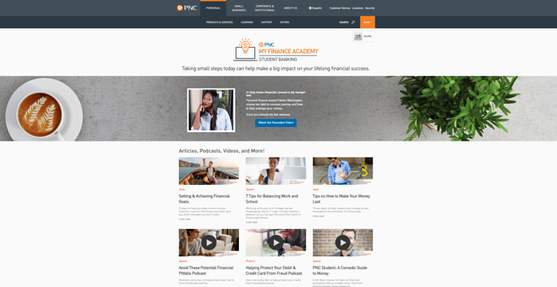

PNC MY FINANCE ACADEMY
Taking small steps today can help make a big impact on your lifelong financial success.
pnc.com/myfinanceacademy
My Finance Academy provides information and
real-world insights for everyday financial challenges.
From understanding financial basics to making
the most of your money, PNC is here to guide
you along the way with My Finance Academy’s
library of educational resources including articles, podcasts, webinars, and more!
©2020 The PNC Financial Services Group, Inc. All rights reserved. PNC Bank, National Association. Member FDIC

Slide 6


READY FOR THE NEXT STEP?
It’s easy to apply for an account.
With your Social Security number and a valid photo ID, you can apply for your PNC account by:
    Visiting pnc.com/temple.
    Visiting your local branch.
    Go to pnc.com/locator to find the closest branch.
©2020 The PNC Financial Services Group, Inc. All rights reserved. PNC Bank, National Association. Member FDIC

Slide 7
WE’RE COMMITTED TO COLLEGE
1 Virtual Wallet Student has no minimum balance requirement or monthly service charge for active students for six years from the date of account opening. You may be asked to provide proof of active enrollment in a qualifying educational institution. At the end of the six years, your account will be converted to Virtual Wallet and subject to the Virtual Wallet Features and Fees in effect at that time. If you transfer this account to a different product or account type during the first six years, you will forfeit the benefits of the Virtual Wallet Student account and will not be able to transfer back to the Virtual Wallet Student account.
2 PNC does not charge a fee for Mobile Banking. However, third-party message and data rates may apply. These include fees your wireless carrier may charge you for data usage and text messaging services. Check with your wireless carrier for details regarding your specific wireless plan and any data usage or text messaging charges that may apply. Also, a supported mobile device is needed to use the Mobile Banking app. Mobile Deposit is a feature of PNC Mobile Banking. Use of the Mobile Deposit feature requires a supported camera-equipped device and you must download a PNC mobile banking app. Eligible PNC Bank account and PNC Bank Online Banking required. Certain other restrictions apply. See the mobile banking terms and conditions in the PNC Online Banking Service Agreement.
3 Federal regulation prohibits you from making more than a total of 6 transfers each month to other accounts from a savings or money market account (including transfers to another account for overdraft protection) or to third parties each month by check, through point-of-sale purchase transactions with a banking card, by preauthorized or automatic agreements, telephone, or online. See your account agreement for more information. Other limits may apply to your account. Excessive transactions may result in changing your Money Market or Savings account to a non-interest-bearing checking account.
4 Zelle should only be used to send or receive money with people you trust. Before using Zelle to send money, you should confirm the recipient’s email address or U.S. mobile phone number. Neither PNC nor Zelle offer a protection program for authorized payments made with Zelle. Zelle is available to almost anyone with a bank account in the U.S. Transactions typically occur in minutes between enrolled users. If the recipient has not enrolled, the payment will expire after 14 calendar days.
5 Your wireless carrier may charge you standard text message rates.
6 Virtual Wallet Student accounts will receive an automatic courtesy refund of the fee for the first Overdraft or Returned Item event. (Spend account only) Although the fee may be refunded, the transaction will be considered an overdraft or nonsufficient funds (NSF) occurrence when determining any subsequent overdraft or NSF fee. You will be responsible for paying the overdraft balance.
Visa is a registered trademark of Visa International Service Association and used under license.
Zelle and the Zelle-related marks are wholly owned by Early Warning Services, LLC and are used herein under license.
Virtual Wallet Student is a registered trademark of The PNC Financial Services Group, Inc.
©2020 The PNC Financial Services Group, Inc. All rights reserved. PNC Bank, National Association. Member FDIC

